Slide 1
Gen AI: Prompt Engineering Best Practices

Slide 2
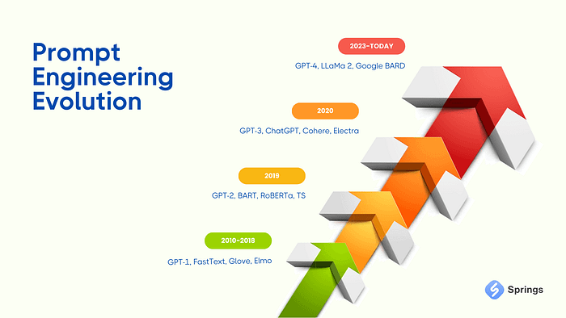
What is ‘Prompt engineering’?
Prompt engineering is the process of structuring text that can be interpreted and understood by a generative AI.
The main goal of prompt is to explain to AI assistant what it should do

Slide 3
Goals:
Understand why knowledge in AI tech is important nowadays
Study Prompts engineering best practices
Write prompts
Take a look at RAG model implemetation

Slide 4
Why knowledge in AI tech is important nowadays
Market is changing with huge speed and ‘Prompt engineering’ is activity that becoming our routine nowadays
Implementation of RAG (Retrieval Argument Generation) it is activity that we inevitably meet in nearest future
A lot of clients want it because:
- AI tools (price per token) becoming cheaper and cheaper
- It can speed up time-to-market
- It can do a lot of different work (support, analyzing, conclusions making)

Slide 5
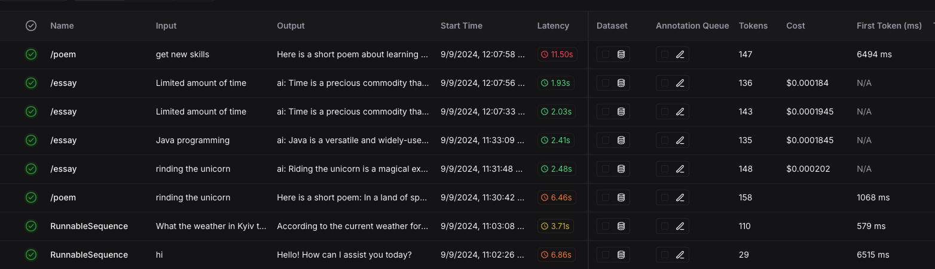
Price per request in OpenAI and Ollama

Slide 6
Prompt Engineering Best Practices:

Slide 7
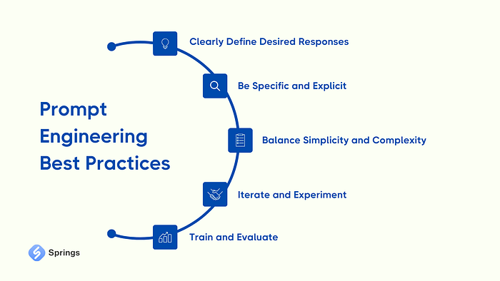

Slide 8
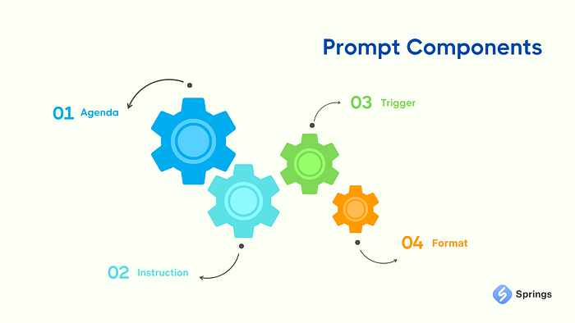
Prompt Components
Agenda: concise introduction or background details to establish the conversational setting
Instruction: Clearly explain the tasks you want the LLM to perform or the specific questions you wish to be addressed
3. Trigger: Provide specific examples that you want the Generative AI model to consider or expand upon
4. Format: Define the desired format for the response, whether it be a bullet-point list, paragraph, code snippet, or any other preferred structure

Slide 9
1. Explain me who I am or how I should act…
Act as a data analyst responsible for improving the product with insights from customer feedback.

Slide 10
2. What should I do?
Using provided data, perform a sentiment analysis of customer feedback to determine the overall impression about product. Identify commons in bad feedbacks and what can be enhanced.

Slide 11
3. In what format you want to get the answer?
Your answer have firstly included your analysis and after analysis you need to provide some quotes that will be taken from context.

Slide 12
4. I need some examples…
Overall impression about product: …
Top common issues in bad feedbacks: […]
Features that can be enhanced: […]

Slide 13
Provide me with data/context…
[
"The new update is fantastic! The reduction in steps from order to delivery is noticeable and convenient. Also, the addition of Apple and Google Pay options simplifies the payment process. A big thumbs up!”,
"Although the reduction in steps for ordering is great, I still struggle to find a noticeable difference in the overall flow. Additionally, adding Apple and Google Pay doesn't help those of us who prefer other payment options.”,
"Loving the streamlined ordering process. It's quicker than before and the integration of Google and Apple Pay options is an exceptional improvement. Makes everything much more efficient!"
]

Slide 14
Example:
Act as a data analyst responsible for improving the product with insights from customer feedback.
Using provided data, perform a sentiment analysis of customer feedback to determine the overall impression about product. Identify commons in bad feedbacks and what can be enhanced.
Your answer have firstly included your analysis and after analysis you need to provide some quotes that will be taken from context.
Example:
Overall impression about product: …
Top common issues in bad feedbacks: […]
Features that can be enhanced: […]
Context: {context}

Slide 15

Me is driving to work coz was ashamed to dance in TikTok in 2020
Me is driving to work coz was lazy to learn Prompt engineering in 2024

